Slide 1

UNIVERSITY INSTITUTEOF ENGINEERING
Bachelor of Engineering (Computer Science & Engineering)
Operating System (20CST/ITT-313)
Subject Coordinator: Er. Puneet kaur(E6913)
Introduction to Operating System
DISCOVER . LEARN . EMPOWER
Font size 24

Slide 2
System Protection and Security
.

Slide 3
Cryptography as a Security Tool
Broadest security tool available
Internal to a given computer, source and destination of messages can be known and protected
OS creates, manages, protects process IDs, communication ports
Source and destination of messages on network cannot be trusted without cryptography
Local network – IP address?
Consider unauthorized host added
WAN / Internet – how to establish authenticity
Not via IP address

Slide 4
Cryptography
Means to constrain potential senders (sources) and / or receivers (destinations) of messages
Based on secrets (keys)
Enables
Confirmation of source
Receipt only by certain destination
Trust relationship between sender and receiver

Slide 5
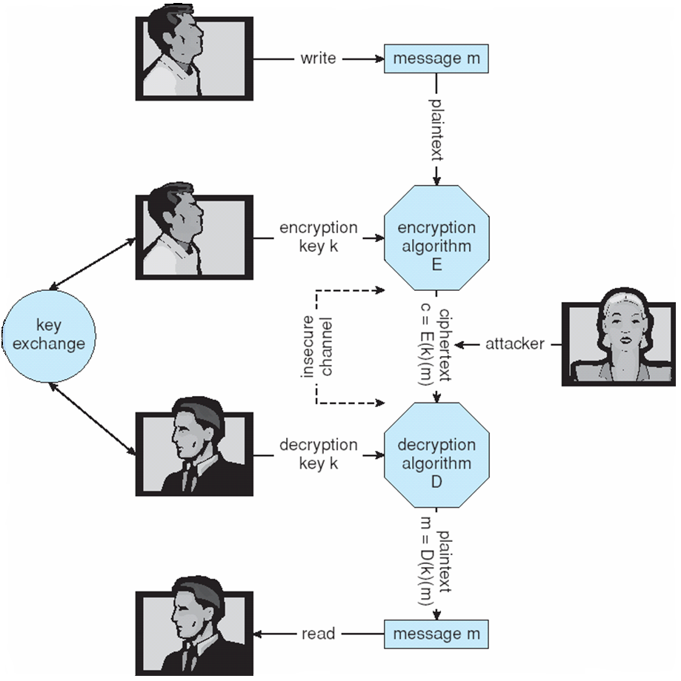
Secure Communication over Insecure Medium

Slide 6
Encryption
Encryption algorithm consists of
Set K of keys
Set M of Messages
Set C of ciphertexts (encrypted messages)
A function E : K → (M→C). That is, for each k ∈ K, E(k) is a function for generating ciphertexts from messages
Both E and E(k) for any k should be efficiently computable functions
A function D : K → (C → M). That is, for each k ∈ K, D(k) is a function for generating messages from ciphertexts
Both D and D(k) for any k should be efficiently computable functions
An encryption algorithm must provide this essential property: Given a ciphertext c ∈ C, a computer can compute m such that E(k)(m) = c only if it possesses D(k)
Thus, a computer holding D(k) can decrypt ciphertexts to the plaintexts used to produce them, but a computer not holding D(k) cannot decrypt ciphertexts
Since ciphertexts are generally exposed (for example, sent on the network), it is important that it be infeasible to derive D(k) from the ciphertexts

Slide 7
Symmetric Encryption
Same key used to encrypt and decrypt
E(k) can be derived from D(k), and vice versa
DES is most commonly used symmetric block-encryption algorithm (created by US Govt)
Encrypts a block of data at a time
Triple-DES considered more secure
Advanced Encryption Standard (AES),
RC4 is most common symmetric stream cipher, but known to have vulnerabilities
Encrypts/decrypts a stream of bytes (i.e., wireless transmission)
Key is a input to psuedo-random-bit generator
Generates an infinite keystream

Slide 8
Asymmetric Encryption
Public-key encryption based on each user having two keys:
public key – public key used to encrypt data
private key – key known only to individual user used to decrypt data
Must be an encryption scheme that can be made public without making it easy to figure out the decryption scheme
Most common is RSA block cipher
No efficient algorithm is known for finding the prime factors of a number which is product of two large prime numbers.

Slide 9
Asymmetric Encryption (Cont.)
Formally, it is computationally infeasible to derive D(k_{d} , N) from E(k_{e} , N), and so E(k_{e} , N) need not be kept secret and can be widely disseminated
E(k_{e} , N) (or just k_{e}) is the public key
D(k_{d} , N) (or just k_{d}) is the private key
N is the product of two large, randomly chosen prime numbers p and q (for example, p and q are 512 bits each)
Encryption algorithm is E(k_{e} , N)(m) = m^{ke} mod N, where k_{e} satisfies k_{e}k_{d} mod (p−1)(q −1) = 1
The decryption algorithm is then D(k_{d} , N)(c) = c^{kd} mod N

Slide 10
Asymmetric Encryption Example
For example. make p = 7and q = 13
We then calculate N = 7∗13 = 91 and (p−1)(q−1) = 72
We next select k_{e} relatively prime to 72 and< 72, yielding 5
Finally, we calculate k_{d} such that k_{e}k_{d} mod 72 = 1, yielding 29
We now have our keys
Public key, k_{e,} N = 5, 91
Private key, k_{d} , N = 29, 91
Encrypting the message 69 with the public key results in the cyphertext 62
Cyphertext can be decoded with the private key
Public key can be distributed in cleartext to anyone who wants to communicate with holder of public key

Slide 11
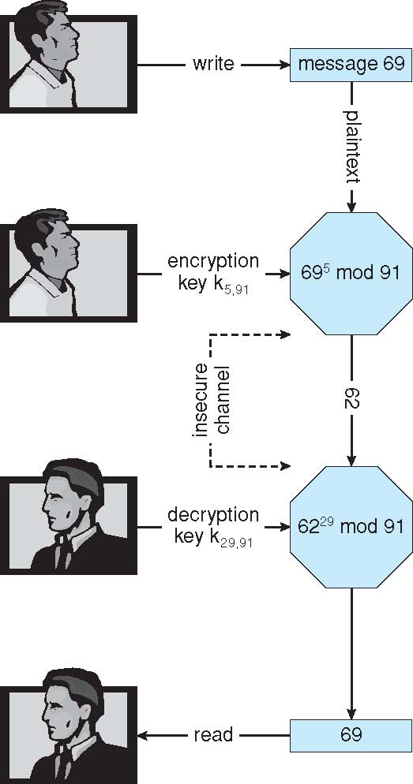
Encryption and Decryption using RSA Asymmetric Cryptography

Slide 12
Cryptography (Cont.)
Note symmetric cryptography based on transformations, asymmetric based on mathematical functions
Asymmetric much more compute intensive
Typically not used for bulk data encryption

Slide 13
Video Links
https://www.edureka.co/blog/what-is-cryptography/ https://book.cyberyozh.com/comprehensive-encryption-of-operating-system-or-hard-disk-drive/

Slide 14
References
https://www.unf.edu/public/cop4610/ree/Notes/PPT/PPT8E/CH15-OS8e.pdf
https://www.tutorialspoint.com/operating_system/os_security.htm
https://www.coursehero.com/file/19323929/Operating-System-Threats-and-Vulnerabilities/
https://www.cs.uic.edu/~jbell/CourseNotes/OperatingSystems/15_Security.html
https://devqa.io/security-threats-attack-vectors/
https://www.geeksforgeeks.org/system-security/
https://www.javatpoint.com/os-security-management

